Slide 1
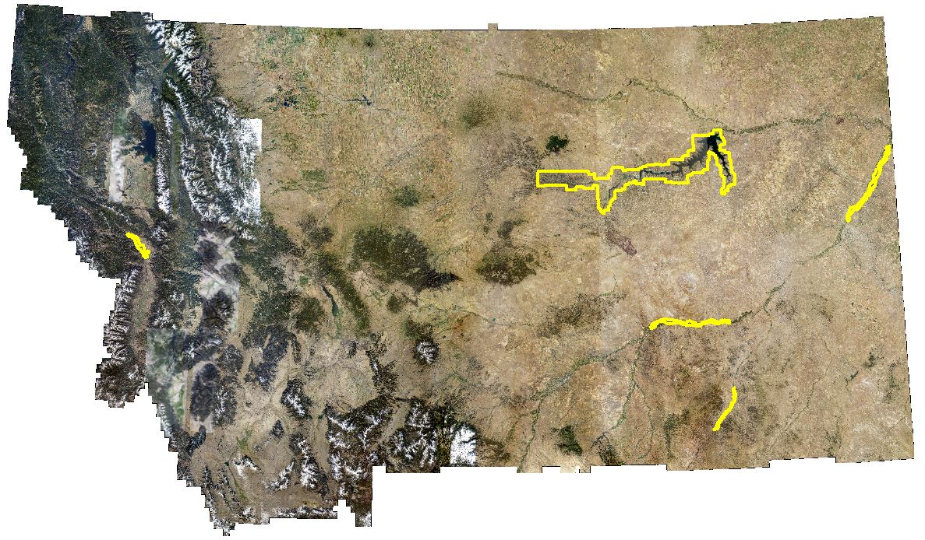
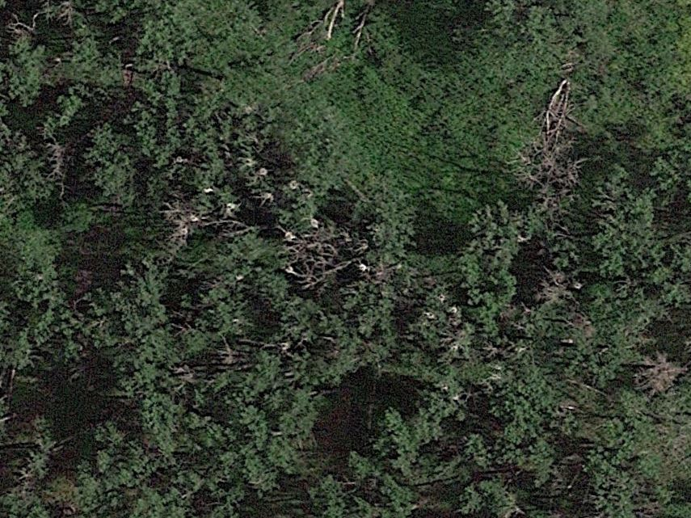
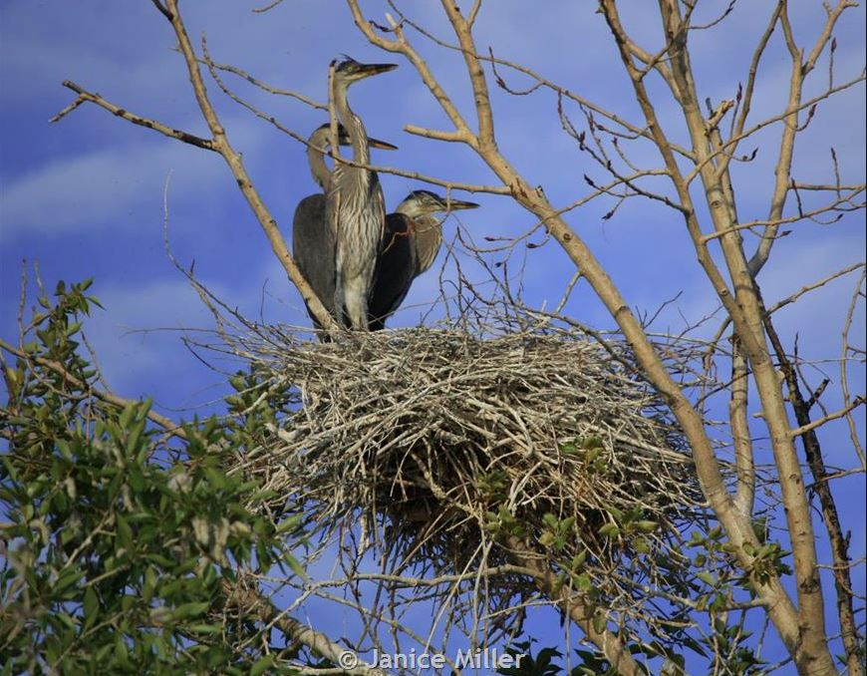
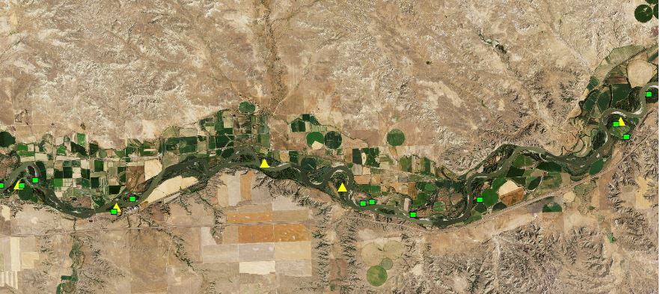
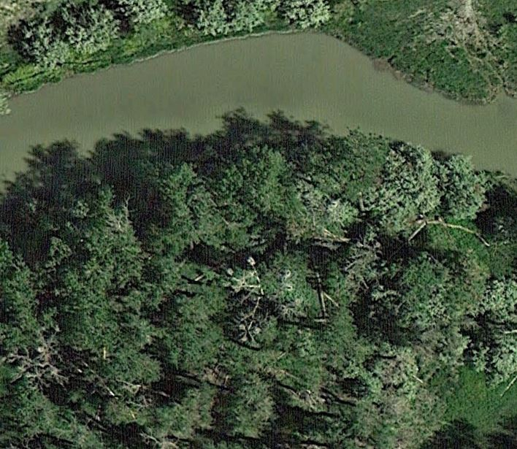
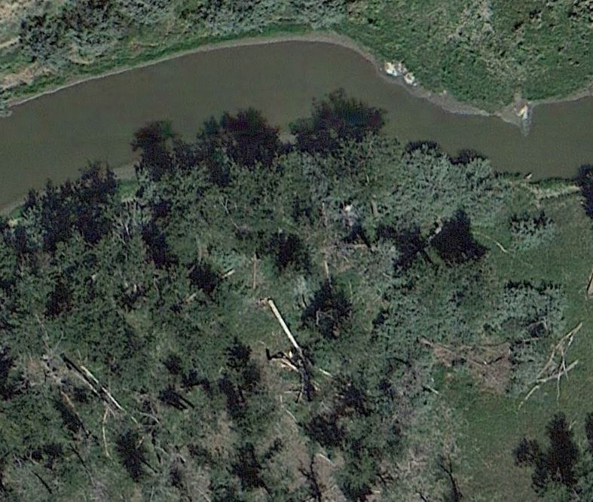


Experimental Mapping of Great Blue Heron Rookeries
in Important Bird Areas Using Aerial Imagery
*Boaz Crees¹, Amy Seaman¹, Dan Bachen², Scott Blum², and Bryce Maxell².
¹Montana Audubon
²Montana Natural Heritage Program
Introduction
The Great Blue Heron (Ardea herodias) is a species of concern in Montana due to population declines and vulnerability to human disturbance and habitat loss (Marks et al. 2016). Analysis of Breeding Bird Survey data show a significant population decline of 2.2% per year between 1966 and 2010, but this estimate is only of moderate quality (Sauer et al. 2011). The Great Blue Heron is an important indicator species as it relies on healthy, productive riparian systems for foraging and nesting. Great Blue Herons are colonial nesters that typically nest in mature cottonwood galleries along major river and stream corridors. They prefer to nest in areas with little human disturbance and low road density, and often abandon colonies (“rookeries”) when disturbed during the egg laying and incubation stages (Gibbs and Kinkel 1997) Rookeries are also sometimes abandoned as a result of tree mortality. Since Great Blue Herons establish nesting rookeries in relatively remote areas, often dozens of miles apart, it can be logistically challenging and costly to survey them. We wanted to determine whether it is possible to effectively survey Great Blue Heron rookeries in Montana using high-resolution satellite and aerial imagery.
Methods
Rookery Identification Using Aerial Imagery
Used aerial imagery of known rookeries outside of the target search area to become familiar with rookery appearance and determine ideal zoom level for rookery detection (700m to 1000m above surface).
Selected riparian corridors within designated Important Bird Areas (IBA’s) that have potential Great Blue Heron nesting habitat. The IBA’s were the Yellowstone River Upper and Lower Reach, Tongue River, Clark Fork- Grass Valley, and Charles M. Russell National Wildlife Area.
Used Google Earth and National Agricultural Imagery Program (NAIP) imagery to systematically scan for rookeries along river corridors using a 270 m x 400 m grid.
Searched “blind”- without knowing locations of historical rookeries.
Switched between available imagery layers whenever imagery quality was low and when a suspected rookery was detected, in order to find the sharpest image and/or to see how rookeries change over time.
Marked newly-found rookeries and compared their locations to known rookeries.
Results
There were 85 historical rookery locations throughout the search area and in 17 of those locations we found rookeries on Google Earth and NAIP imagery.
In the initial “blind” search we were able to detect 16 of 17- or 94%- of the detectable rookeries.
We detected 8 new rookeries that were not previously reported.
Time to map the entire target area was <4 days.
Table 1. Summary of found and historical Great Blue Heron rookeries across five Important Bird Areas (IBA) in Montana
IBA | Total # historical rookeries | Historical rookeries not found during "blind" mapping or review* | Historical rookeries identified during "blind" mapping | Historical rookery present but overlooked during "blind" mapping | Unreported rookeries detected during "blind" mapping
Yellowstone | 57 | 45 | 12 | 1 | 3
CMR | 7 | 7 | 0 | 0 | 1
Tongue | 7 | 6 | 1 | 0 | 2
Clark Fork | 14 | 11 | 3 | 0 | 2
Total | 85 | 68 | 16 | 1 | 8
* We believe the majority of the undetected historical rookeries were abandoned at some point in the past and were no longer detectable.
3
Discussion
Nearly all rookeries we found had a distinctive appearance that made them easily discernable from the background.
Mapping rookeries using aerial imagery appears to be effective but ground truthing is necessary to verify rookeries are not being missed or misidentified. Montana Audubon is planning on sending volunteers to survey a subset of the rookeries we identified, both new and historical.
To be most useful, rookery mapping efforts rely on up-to-date, high resolution aerial imagery. Currently the best imagery layers are not necessarily the most recent. As imagery quality and recency improve, so will our ability to assess rookery and population trends for this vulnerable species.
Based on the amount of time needed to survey the selected IBA’s we estimate it will take about 20-30 days to survey the entire state using aerial imagery. Depending on our findings during the upcoming volunteer surveys, it may be worthwhile to continue mapping rookeries on all major waterways in Montana in order to establish a rookery location baseline. Comparing this baseline to future aerial imagery will allow us to see individual rookery growth, decline and movement, and may help us determine the cause of such changes (Fig. 5). Comparison of the number of rookeries, and nests within rookeries, will allow for better assessment of population trends and conservation status for this species in Montana.
Aerial imagery surveys offer a simple, cost effective way of finding unreported rookeries in remote areas or areas lacking other types of structured surveys.
It appears we can get reasonably accurate nest counts in most rookeries using this survey method. While these nest counts offer little direct information about the actual nesting outcome, they can point to breeding population size and trends when assessed over time and on a watershed scale.
1
2
4
5
Figure 1. Important Bird Areas surveyed for Great Blue Heron rookeries using NAIP aerial imagery 1) Clark Fork- Grass Valley, 2) Charles M. Russell National Wildlife Area, 3) Yellowstone River Lower Reach, 4) Yellowstone River Upper Reach, 5) Tongue River
Objectives
Investigate whether it is possible to find Great Blue Heron rookeries using high-resolution satellite imagery and aerial photography.
Test the reliability of this method by comparing newly-found rookery locations to previously reported colonies.
Figure 2. Unreported rookery discovered using aerial imagery. For rookery identification we cued in on clusters of white specs within riparian forests. Upon closer inspection the actual nest structures were usually clearly visible. We found that individual nests are consistently about 1 m in diameter. This helped in areas with lower image quality, where it was otherwise challenging to determine whether a blurry nest-like shape was in fact a nest.
Comparison of Identified Versus Historical Rookeries
Compared point-locations of all historical rookeries in the Montana Natural Heritage Program database to the rookeries identified using only aerial imagery (Fig. 3).
Used aerial imagery to closely review every historical rookery that was not independently identified- and thus potentially missed- during the “blind” survey.
a
b
Figure 5. Left panel (a) shows potentially active rookery visible on June 16, 2013. Right panel (b) shows the same rookery location one month later. Note the rookery tree appears to have fallen and the nests are no longer visible. If active, the loss of this rookery occurred during peak breeding season and probably impacted local recruitment.
Figure 3. Map showing historical rookeries (green squares), and rookeries found during blind aerial imagery search (yellow triangles) along a portion of the Yellowstone River.
References
Gibbs, J.P., and L.K. Kinkel. 1997. Determinants of the size and location of Great Blue Heron Colonies. Colonial Waterbirds 20(1):1-7
Marks, J.S., P. Hendricks and D. Casey. 2016. Birds of Montana. Arrington, VA: Buteo Books. 657 p.
Sauer, J.R., J.E. Hines, J.E. Fallon, K.L. Pardieck, D.J. Ziolkowski, Jr., and W.A. Link. 2011. The North American Breeding Bird Survey, Results and Analysis 1966 - 2010. Version 12.07.2011.

